Slide 1
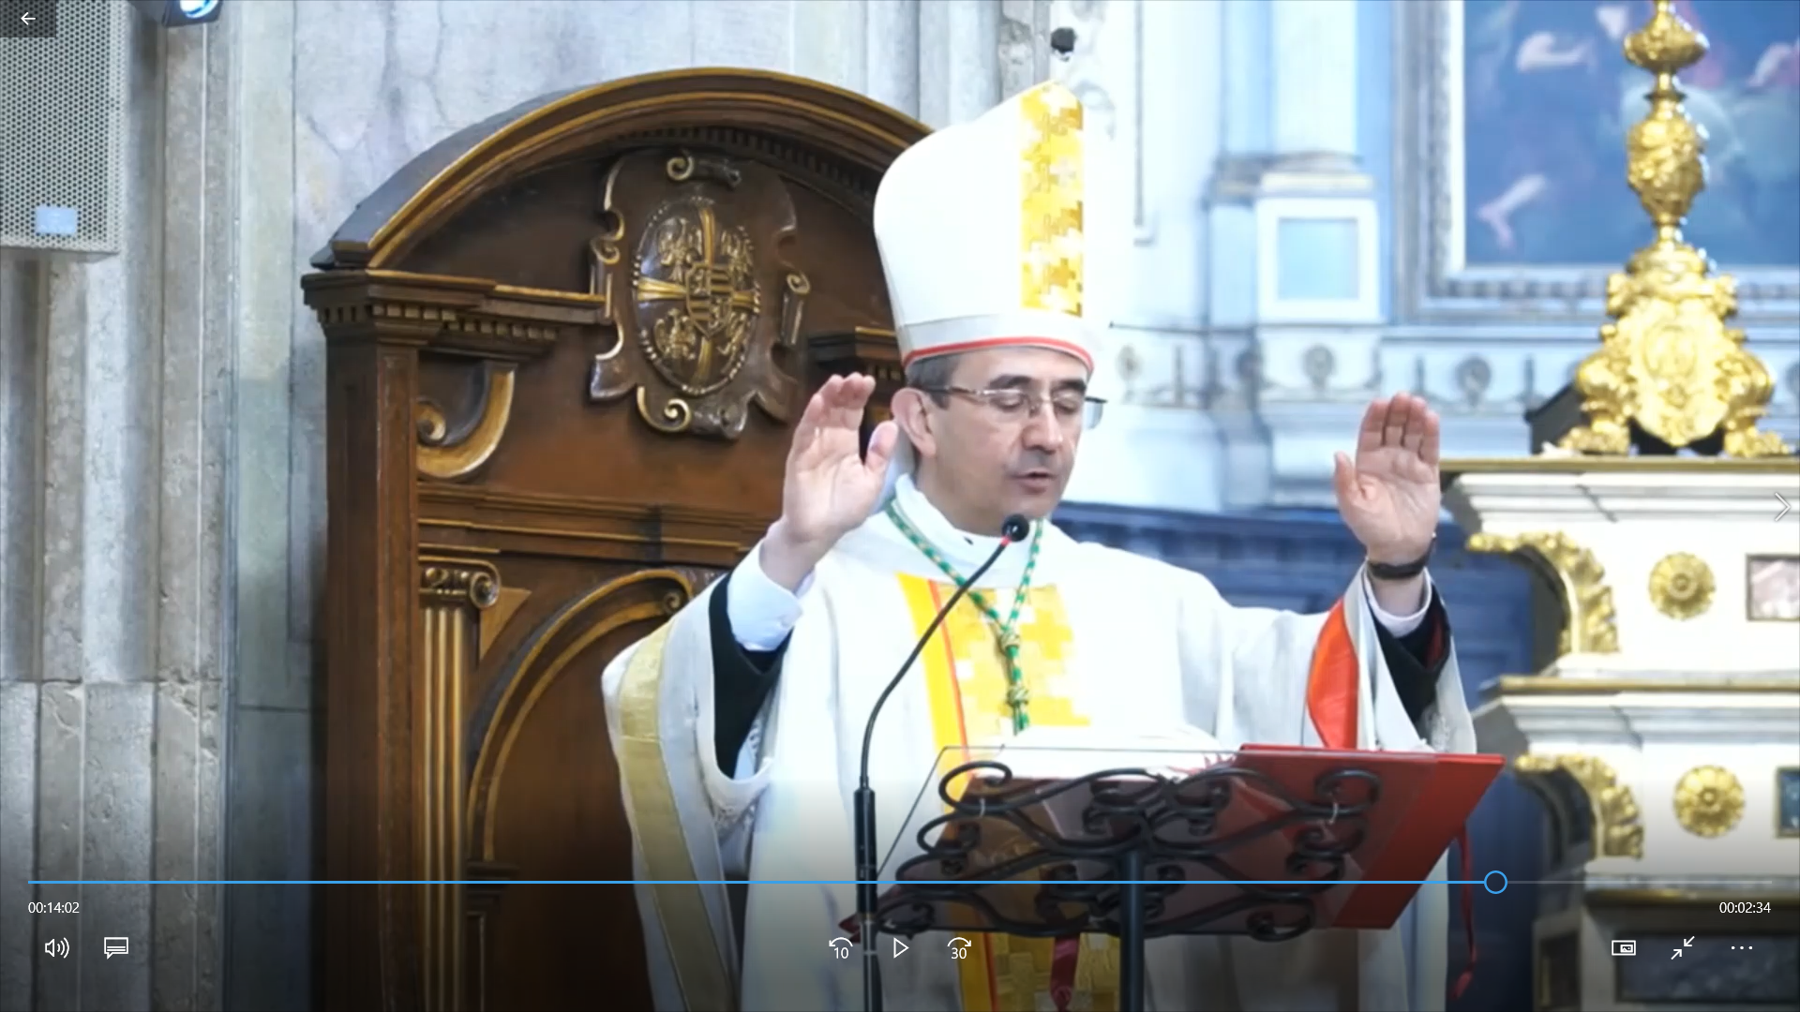
Deepfake of a Priest Reading an Artificial Bible
Artistic Practices II Project by Ludovica Schaerf

Slide 2
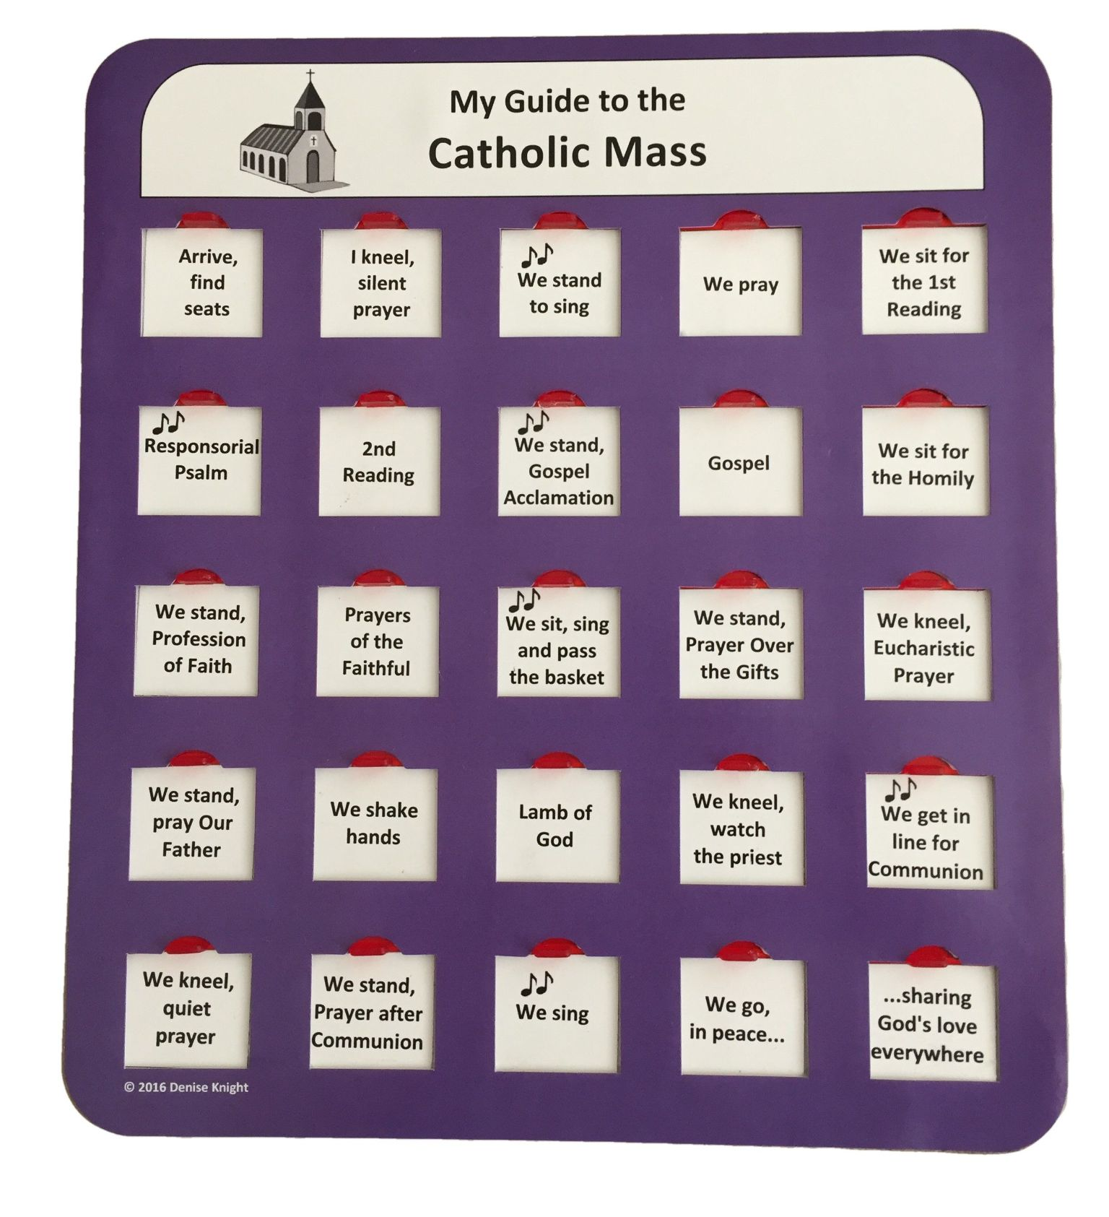
Why tho??
The Christian mass is still profoundly Biblical
No introduction to the readings only Homily
Poses issue of Hermeneutics
Notes:
Homily: In the homily, the priest follows the example of Christ on the road to Emmaus, explaining and interpreting the Scriptures. Sometimes this interpretation is biblical, sometimes theological, sometimes moral or catechetical (Lk 24:13-35). Always, however, again in imitation of the Emmaus encounter, it should prepare the congregation for or point us toward what is about to follow: the Liturgy of the Eucharist.
https://www.britannica.com/topic/hermeneutics-principles-of-biblical-interpretation

Slide 3
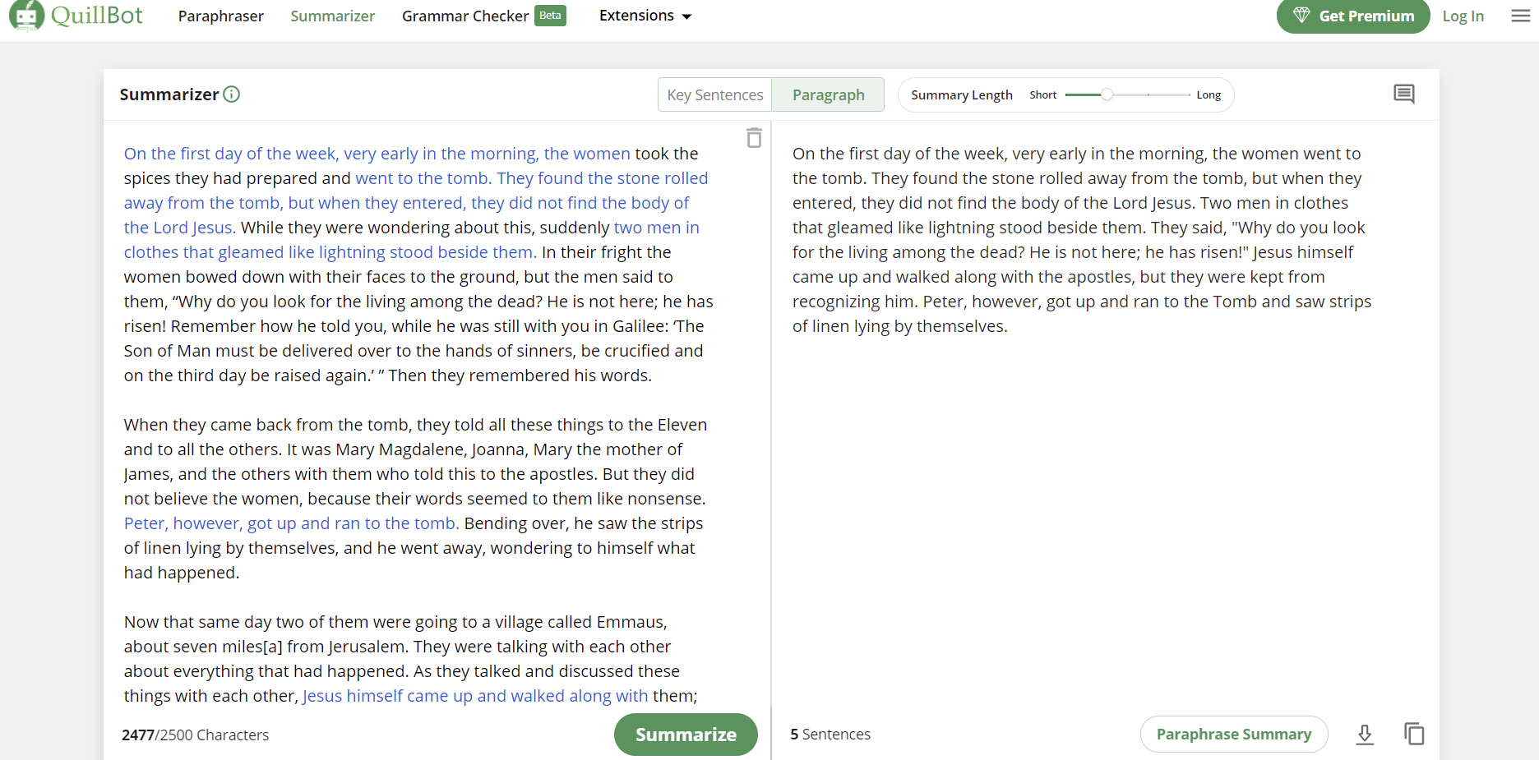
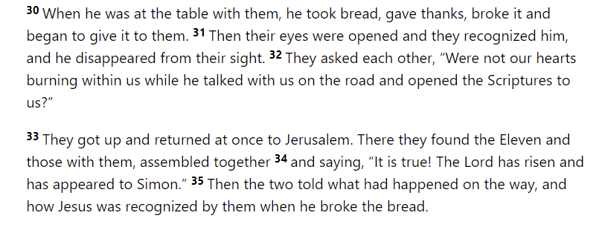
Artificial Bible
Bible, Luke 24,
“Jesus has risen”
Notes:
i was therefore thinking of introducing the summary of the Bible as a sort of 'in the previous episodes' where the AI summary of a specific chapter is read out by the priest before going into the passage he wants to read. This would serve as a context for the people attending the mass and give a more unbiased introduction to the passage. in terms of format, I thought about accentuating the role of AI and make a deepfake video of a priest giving the mass to which I would substitute the audio of the 'personal introduction' with the AI-made summary.Especially given you ground these reasons into believers’ need to understand how such passages are connected to a bigger text, something they realize could be helpful. Perhaps there are multiples ways to think of these connections to “previous episodes” : obviously the text that was before in the Bible, but also other texts that are related (and that the AI can find connections to).

Slide 4

Deepfake of a priest
original audio → Priest Homily
example output sentence
real-time voice cloning
Simulation or Simulacrum?
(Jean Baudrillard)
Notes:
https://en.wikipedia.org/wiki/Simulacra_and_Simulation#:~:text=Simulacra%20and%20Simulation%20(French%3A%20Simulacres,media%20involved%20in%20constructing%20an
The first stage is a faithful image/copy, where we believe, and it may even be correct, that a sign is a "reflection of a profound reality" (pg 6), this is a good appearance, in what Baudrillard called "the sacramental order".
The second stage is perversion of reality, this is where we come to believe the sign to be an unfaithful copy, which "masks and denatures" reality as an "evil appearance—it is of the order of maleficence". Here, signs and images do not faithfully reveal reality to us, but can hint at the existence of an obscure reality which the sign itself is incapable of encapsulating.
The third stage masks the absence of a profound reality, where the sign pretends to be a faithful copy, but it is a copy with no original. Signs and images claim to represent something real, but no representation is taking place and arbitrary images are merely suggested as things which they have no relationship to. Baudrillard calls this the "order of sorcery", a regime of semantic algebra where all human meaning is conjured artificially to appear as a reference to the (increasingly) hermetic truth.
The fourth stage is pure simulacrum, in which the simulacrum has no relationship to any reality whatsoever. Here, signs merely reflect other signs and any claim to reality on the part of images or signs is only of the order of other such claims. This is a regime of total equivalency, where cultural products need no longer even pretend to be real in a naïve sense, because the experiences of consumers' lives are so predominantly artificial that even claims to reality are expected to be phrased in artificial, "hyperreal" terms. Any naïve pretension to reality as such is perceived as bereft of critical self-awareness, and thus as oversentimental.

Slide 5

turns out audio ai ain’t that intelligent after all

Slide 6
Implications
Can we popularize the liturgy, extending its understanding to sporadic churchgoer?
Is an AI Summary more unbiased than human ones? Would this ‘solve’ the issue of interpretation?
Can Artificial Intelligence interact with the Sacred? Would this be profane?
Is the vast use of AI distancing ourselves from reality? Can we trust the resulting summary?

Slide 7
What’s Next
How is this received:
video extended with interviews after the mass
real interviews’ text still displayed a deepfake audio
guess negative reaction

